Slide 1




Slide 2
CHAPTER 10
ERROR HANDLING
& DEBUGGING

Slide 3
JavaScript can be hard to learn. Everyone makes mistakes when writing it.

Slide 4
Error messages can help you understand what has gone wrong and how to fix it.

Slide 5
You will learn about:
The console and developer tools
Common problems
Handling errors

Slide 6
HOW JAVASCRIPT WORKS

Slide 7
To find the source of an error it helps to understand how scripts are processed.

Slide 8
The order of execution is the order in which lines of code are executed or run.

Slide 9
function greetUser() { return ‘Hello ’ + getName();
} function getName() { var name = ‘Molly’; return name;
} var greeting = greetUser(); alert(greeting);
LOOK AT THIS SCRIPT:

Slide 10
function greetUser() { return ‘Hello ’ + getName();
} function getName() { var name = ‘Molly’; return name;
} var greeting = greetUser(); alert(greeting);
1

Slide 11
function greetUser() { return ‘Hello ’ + getName();
} function getName() { var name = ‘Molly’; return name;
} var greeting = greetUser(); alert(greeting);
2

Slide 12
function greetUser() { return ‘Hello ’ + getName();
} function getName() { var name = ‘Molly’; return name;
} var greeting = greetUser(); alert(greeting);
3

Slide 13
function greetUser() { return ‘Hello ’ + getName();
} function getName() { var name = ‘Molly’; return name;
} var greeting = greetUser(); alert(greeting);
4

Slide 14
There are execution contexts:
One global context
And a new execution context for each new function

Slide 15
function greetUser() { return ‘Hello ’ + getName();
} function getName() { var name = ‘Molly’; return name;
} var greeting = greetUser(); alert(greeting);
GLOBAL CONTEXT
(global scope)
FUNCTION CONTEXT
(function-level scope)

Slide 16
The JavaScript interpreter processes code one line at a time.

Slide 17
If a statement needs data from another function, it stacks (or piles) functions on top of the current task.

Slide 18
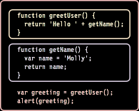
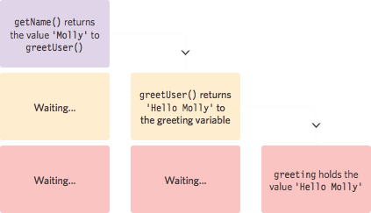
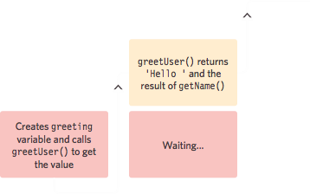

Slide 19
When a script enters a new execution context, there are two phases of activity:
1: Prepare
2: Execute

Slide 20
ERRORS

Slide 21
If a JavaScript statement generates an error, then it throws an exception.

Slide 22
It stops… and looks for exception handling code.
If error handling code cannot be found in the current function, it goes up a level.

Slide 23
If error handling code cannot be found at all, the script stops running.
An Error object is created.

Slide 24
Error objects help you find where your errors are.
Browsers have tools to help you read them.

Slide 25
Error objects have these properties: name type of execution message description of error fileName name of JavaScript file lineNumber line number of error

Slide 26
Seven types of Error object:
Error
SyntaxError
ReferenceError
TypeError
RangeError
URIError
EvalError

Slide 27
A DEBUGGING WORKFLOW

Slide 28
Debugging is about deduction and eliminating potential causes of errors.
To find out where the problem is, you can check…

Slide 29
1
The error message
The line number
The type of error

Slide 30
2
How far the script has run

Slide 31
3
Values in code by setting breakpoints and comparing the values you expect to what the variables hold

Slide 32
THE CONSOLE & DEVELOPER TOOLS

Slide 33
All modern browsers have developer tools to help you debug scripts.
Start by opening the JavaScript console.

Slide 34

1: Console is selected
2: Type of error (SyntaxError)
3: File name and line number:
(errors.js:4)
1
2
3

Slide 35
1: Console is selected
2: Type of error (SyntaxError)
3: File name and line number:
(errors.js:4)
1
2
3

Slide 36
1: Console is selected
2: Type of error (SyntaxError)
3: File name and line number:
(errors.js:4)
1
2
3

Slide 37
You can just type code into the console and it will show you a result.

Slide 38
The console.log() method will write code to the console as it is processed.

Slide 39
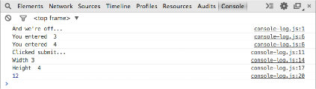

Slide 40
These methods show messages like log() but have a slightly different style: console.info() console.warn() console.error()

Slide 41


Slide 42
You can group error messages with: console.group(‘Areas’); console.info(‘Width ‘, width); console.info(‘Height ‘, height); console.log(area); console.groupEnd();

Slide 43


Slide 44
You can write arrays and object data into a table with: console.table(objectname);

Slide 45
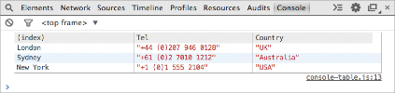

Slide 46
You can write on a condition with: console.assert(this.value > 10,
'User entered less than 10');

Slide 47


Slide 48
Breakpoints let you pause the script on any line, allowing you to then check the values stored in variables.

Slide 49
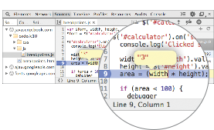
1: Sources is selected
1
4
2
3

Slide 50
2: Script is chosen
1
4
2
3

Slide 51
3: Line number is clicked on
1
4
2
3

Slide 52
4: Variable is hovered over
1
4
2
3

Slide 53
If you have several breakpoints, you can step through them one by one.

Slide 54
1: Pause button turns into a play button when a breakpoint is encountered
1
2
3
4

Slide 55
2: Go to next line of code and step through the lines one-by-one
1
2
3
4

Slide 56
3: Step into a function call
1
2
3
4

Slide 57
4: Step out of a function that you stepped into
1
2
3
4

Slide 58
You can create a breakpoint with the debugger keyword: if (area < 100) { debugger;
}

Slide 59
HANDLING EXCEPTIONS

Slide 60
If you know your code could fail, you can use try, catch, and finally.
Each gets its own code block.

Slide 61
try {
// Try to run this code
} catch (exception) {
// If an exception occurs, run this code
} finally {
// Always gets executed
}

Slide 62
try {
// Try to run this code
} catch (exception) {
// If an exception occurs, run this code
} finally {
// Always gets executed
}

Slide 63
try {
// Try to run this code
} catch (exception) {
// If an exception occurs, run this code
} finally {
// Always gets executed
}

Slide 64
try {
// Try to run this code
} catch (exception) {
// If an exception occurs, run this code
} finally {
// Always gets executed
}

Slide 65


